Slide 1
Bookish Media
#BookTalks
#BookFaceFriday
#BookBentos
#BookSnaps
A quick-start guide with everything you need to turn your social media account into a literary dream

Slide 2
Book Talks
Book Talks are sort of like teaser trailers created with a "hook" to draw the prospective reader in. Some examples are reading a line/lines from the book that inspire further inspection, "acting" the book talk as a character from the book, and focusing on the art style of the book. One example was focused on the physical construction of the book, which was beautifully presented with heavy paper and distinctive art, and using it to set an ideal scene for a book - reading a book on a winter day with a cup of tea and a cat. Here is a website with a basic overview: https://www.weareteachers.com/what-is-a-book-talk/

Slide 3
Pick a hook, any hook! A hook will give your Book Talk the “oomph” it needs to get your viewer, well, hooked.

Slide 4
Resources
How to do a Book Talk -https://www.youtube.com/watch?v=kln1mTngLq4
Bring the HEAT - https://www.youtube.com/watch?v=kRkqjudkaME
30 Second Book Talk - https://www.youtube.com/watch?v=Rx2EuTc9w6g
The 30 Second Book Talk championship - https://www.youtube.com/watch?v=dFubOP_Jpvg

Slide 5
BookBentos
BookBentos are a very fun and multi-faceted way to incorporate many different forms of media including author interviews, book reviews, and blog posts into a functional and aesthetically pleasing photo template resembling a Japanese Bento box. At face value, it is a collage in a rectangular shape that uses thematic elements from the book. Using other applications, this can be delved further into by creating clickable links that lead to the aforementioned media relating to the book. Here is an article explaining more about them and highlighting some of this work. http://blogs.slj.com/neverendingsearch/2019/05/04/building-beautiful-book-bentos/

Slide 6
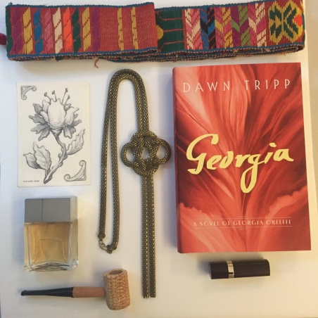
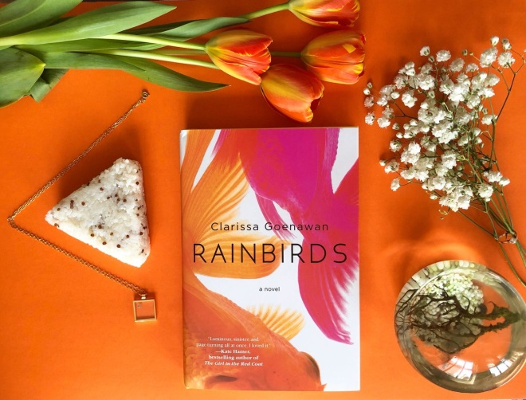
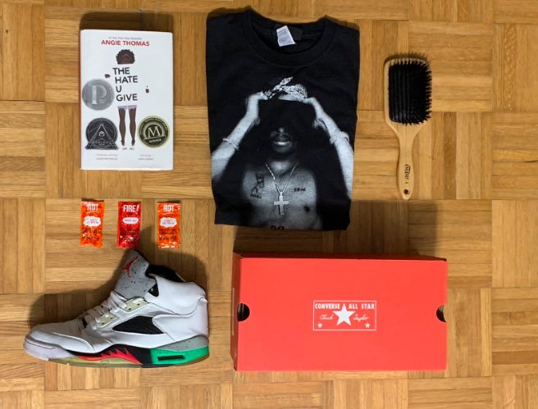
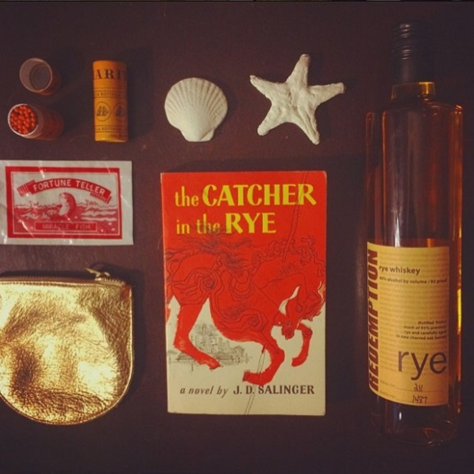
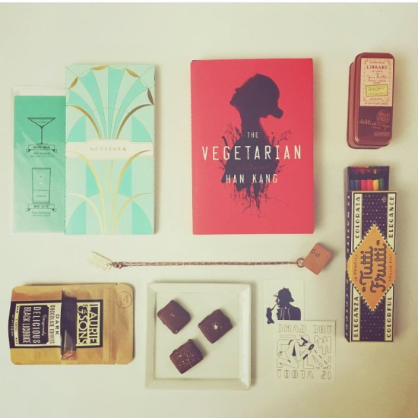
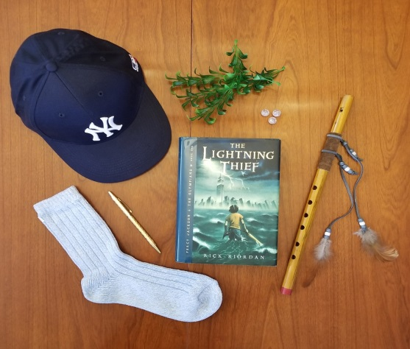
Resources
BookBento explained - https://www.youtube.com/watch?v=pEZFXFCySWA
BookBentos: a bookworm’s dream come true - https://www.elledecor.com/life-culture/fun-at-home/news/a8635/book-bento-instagram-account/

Slide 7
BookSnaps
BookSnaps: BookSnaps originated in Snapchat but do have a relatively robust community of users in Instagram. They made use primarily of the transient nature of Snapchat, using the snap as a quick teaser for a book, perhaps including personal touches like Bitmojis to personalize the post. A good place to start is to quote a particular line from the book, write a quick rating over the top and include a Bitmoji of yourself with a relevant reaction to the subject matter. More information can be found here: https://www.tarammartin.com/booksnaps-snapping-for-learning/

Slide 8
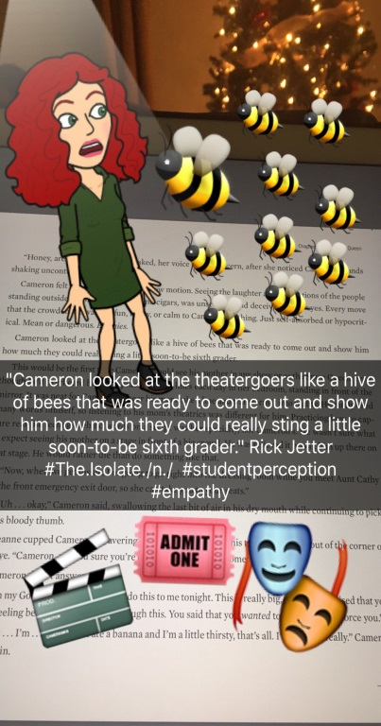
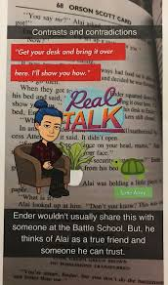
Resources
How to create a BookSnap - https://www.youtube.com/watch?v=V_p8S2hIVqQ

Slide 9
#BookFaceFridays
Bookface involves strategically lining up your face or another body part alongside a book cover that features a matching body part so that there appears a melding of life and art. Librarians and other book lovers post these photos weekly on visual apps like Instagram, using the caption #BookfaceFriday.

Slide 10
Resources
https://www.nytimes.com/2015/05/03/fashion/oh-those-clever-librarians-and-their-bookface.html
How to get the perfect shot for your #BookFace -https://www.dundurn.com/news/BookFaceFriday-Why-and-How

Slide 11
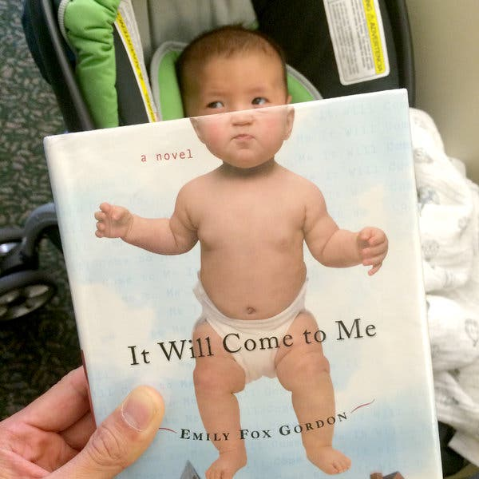
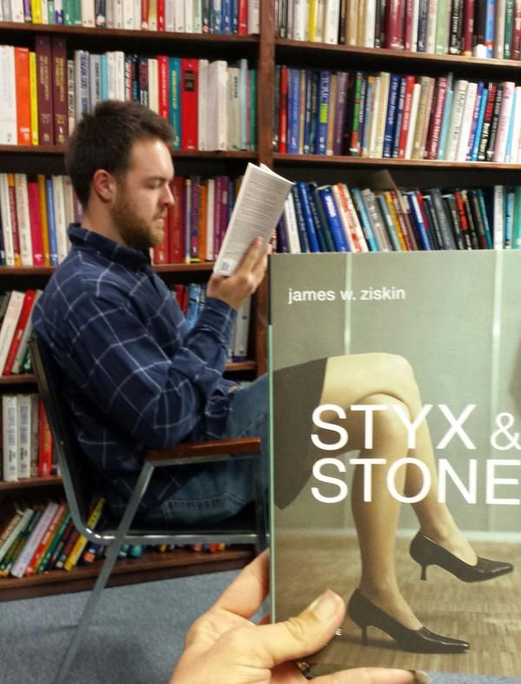

Slide 12
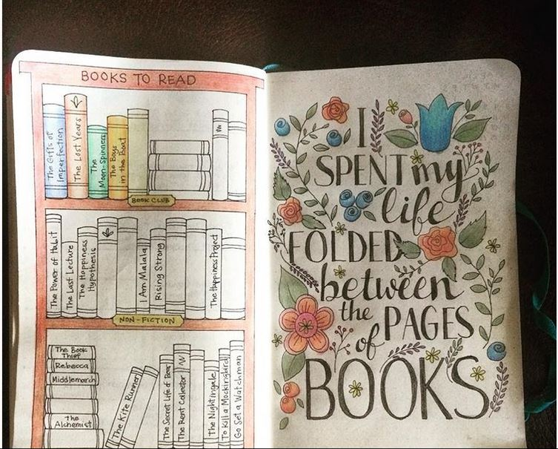
BONUS!
If all this got you hungry for more, check this cool guide on how to personalize your own reading journal - https://www.bookish.com/articles/bullet-journal-bookworms/

